Slide 1
MUTEESA I ROYAL UNIVERSITY • ICT 1105 GROUP 4
Bright High School Luwero Website
Design, Development, and Deployment of a Responsive Ten-Page Portal
Mugerwa Marvin (25/U/BIT/0032/K/WKD) | Mukisa Alvin (26/U/BIT/0008/K/WKD)

Slide 2
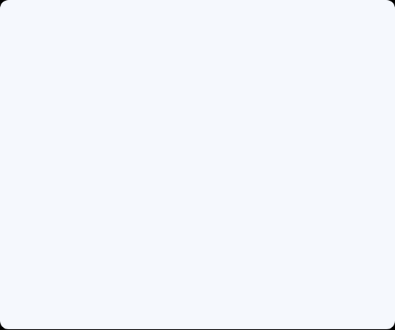
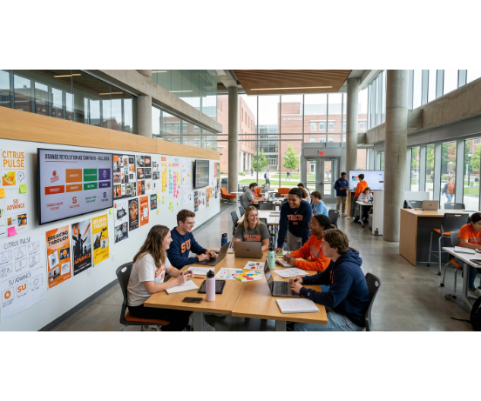
Project Scope & Purpose
Central online information hub connecting parents, learners, staff, and community stakeholders.
•
Ten Pages: Complete institutional coverage from admissions to contact.
•
Static Front-End: Hand-coded HTML5 and CSS3 without frameworks.
•
24/7 Access: Eliminates routine walk-in and phone inquiries.

Slide 3
Current Gaps vs. Web Solution
Existing Challenges
Website Solution
•
•
Unified Portal: Ten structured pages under one menu.
Scattered Notices: Information trapped on physical boards.
•
•
Self-Service: Instant access to fees, dates, and FAQs.
Office Delays: Repetitive phone calls during admissions.
•
•
Mobile Ready: Responsive layouts for Android phones.
Limited Reach: No off-hours access to fee structures.
•
•
Rich Media: Eight gallery photos and captioned video.
Low Visibility: Few photos of student life and labs.

Slide 4




Target Audience & User Needs
Parents
Prospective Learners
Current Students
Staff & Alumni
Admissions fees and quick contacts.
Subjects, clubs, and campus tours.
Term calendars and school events.
School heritage and community updates.

Slide 5
PART 01 • SYSTEM ARCHITECTURE
Information Architecture & Visual Design

Slide 6
Flat Ten-Page Site Architecture
Page | File | Core Content | Page | File | Core Content
Home | index.html | Hero & prospectus form | Student Life | student-life.html | Clubs, sports & boarding
About Us | about.html | Mission, vision & history | Gallery | gallery.html | 8 captioned photos
Academics | academics.html | O/A-Level curriculum table | Media Centre | media.html | Video & text transcript
Admissions | admissions.html | Fees table & application | FAQ | faq.html | 6 expandable answers
Programmes | services.html | ICT & career guidance | Contact Us | contact.html | Enquiry form & Luwero map

Slide 7
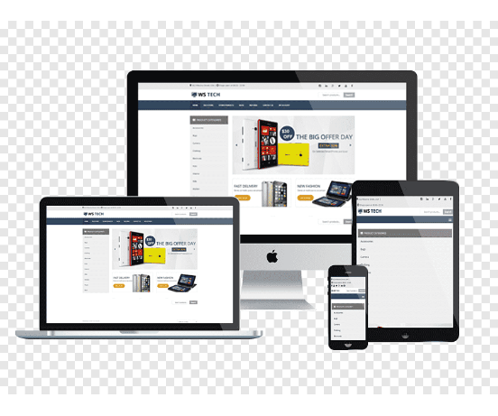
Responsive Design & Breakpoints
Single external stylesheet (css/style.css) adapts layouts from 320 px to 1920 px with zero horizontal overflow.
•
≤ 900 px (Tablets): Single-column hero and two-column cards.
•
≤ 600 px (Phones): Full-width buttons and touch-scrollable nav.
•
≤ 360 px (Small Phones): Compact padding and scrollable tables.

Slide 8



Key HTML5 & Accessibility Features
Semantic HTML5
Validated Forms
WCAG 2.2 AA
Landmarks, rowspan/colspan tables, and native FAQ accordions.
Three forms enforcing required, email, pattern, and minlength rules.
Skip links, focus rings, WebVTT captions, and 6.3:1 text contrast.

Slide 9
Version Control & GitHub Pages Workflow
01
02
03
04
Feature Branches
Tracked Commits
Pull Requests
Live HTTPS Site
Isolated member development per page.
6+ meaningful commits per group member.
Peer-reviewed merges into main branch.
Published from root via GitHub Pages.

Slide 10
Testing & Validation Metrics
20 / 20
0 Errors
< 200 KB
3 Users
Test Cases Passed
W3C HTML & CSS Validators
Optimised Image Size Cap
Live Usability Sessions
Key Audit Fixes: Corrected map coordinates to Luwero, separated uniform fees from tuition, and improved muted text contrast to 6.3:1.

Slide 11
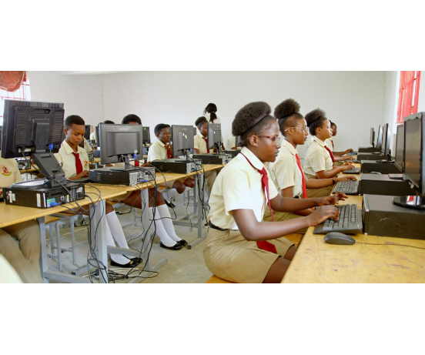
Live Demonstration & Viva Readiness
Both team members are prepared to demonstrate live functionality and defend architectural choices.
•
Live Walkthrough: Open GitHub Pages URL on desktop and mobile.
•
Code Defense: Explain CSS Grid, Flexbox, and form validation attributes.
•
Git Traceability: Present individual commits and merged pull requests.

Slide 12
BRIGHT HIGH SCHOOL LUWERO • ICT 1105
Thank You & Questions
Group 4: Mugerwa Marvin & Mukisa Alvin • Ready for Live Demo & Viva

